Slide 1

DEPARTMENT OF COMPUTER SCIENCE AND ENGINEERING(Data Science)
Enhancing Women's Safety with IoT-Powered Sensor Devices
This presentation explores how IoT technology can revolutionize women's safety through sensor-enabled devices that detect threats and automatically send alerts, enabling faster, more effective crisis response compared to manual activation systems.
Team:
A.S.Abhiram 217R1A7403 Under The Guidance of
G.Sainith Reddy 217R1A7427 Mr. P.N Santosh Kumar(Associate Professor)
M.Nithin Sai 217R1A7443
by Batch 13

Slide 2
Contents
Understanding of the problem
Literature Review & Summary
5Design/Modeling
Preparation of the Problem
Implementation
Expected Output
References

Slide 3

Understanding the Problem
The problem this project addresses is the lack of reliable, autonomous safety devices for women in dangerous situations. Existing systems often require manual activation, which can be impractical or impossible during emergencies. This project aims to develop and Women worldwide face significant safety concerns, with millions experiencing harassment, violence, and abuse in public and private spaces. According to global statistics, approximately 35% of women have experienced physical or sexual violence in their lifetime, and many cases remain unreported due to fear or lack of immediate assistance. These alarming figures highlight the need for responsive safety solutions that can operate autonomously and discreetly.

Slide 4
Literature Survey
Gaps:
1
Existing Safety Devices
[1] 1Muhammad Shoaib Farooq, 1Ayesha Masooma, “Role of Iot in Womens safety,", 2023.
[2] Lauren F. Cardoso, SaraLanders, "Recent and emerging technologies: Implications for women's safety," Technology in Society, 2019.
They have the limitations of current women's safety technologies and their dependence on manual activation.
2
IoT Applications
IoT sensors and automation can applied in other domains to improve response times.
3
Machine Learning Techniques
Investigate advanced algorithms for real-time threat detection and classification using sensor data.

Slide 5
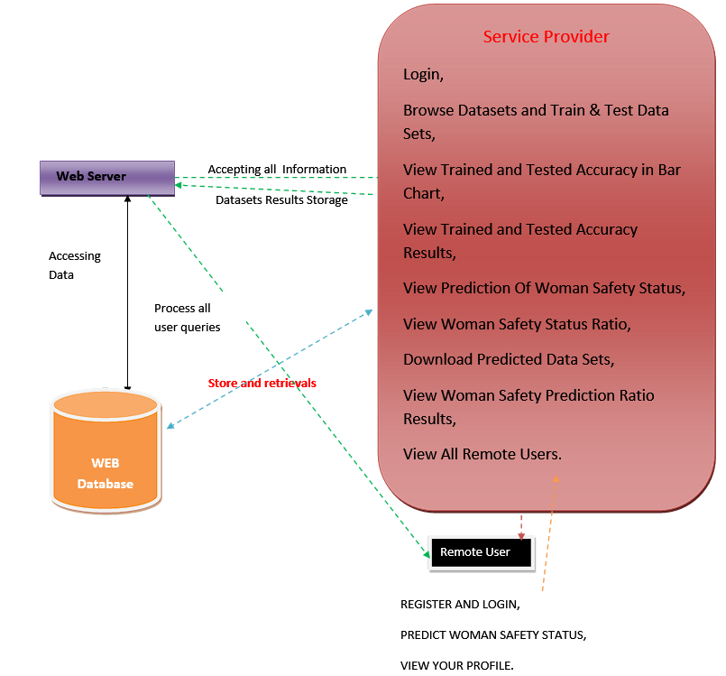
Design or Modelling

Slide 6
Preparation of the Problem
Women’s safety is a critical issue, with many cities lacking real-time monitoring systems to assess safety conditions.
IoT is not limited to physical sensors; it also includes digital data sources like social media, which can act as virtual safety indicators.
Social media platforms, especially Twitter, are often used to report safety concerns, incidents, and experiences in different cities.
The proposed solution is a web portal that both collects user-made tweets related to women’s safety, and also analysis of CCTV footage across the city and , classifies them using sentiment analysis, and presents safety statistics for different locations.
This system allows authorities, organizations, and individuals to access real-time data and make informed decisions regarding safety.

Slide 7
Implementation
The web portal fetches tweets related to women’s safety using the Twitter API and processes them using Natural Language Processing (NLP).
Sentiment analysis categorizes tweets into positive (safe) and negative (unsafe) based on their content.
A dashboard is created where users can upload safety-related tweets manually, and an admin panel allows authorities to view and compare safety trends across cities.
The system is built using Python (Flask/Django) for backend, NLP libraries (TextBlob/VADER) for sentiment analysis, and HTML/CSS, JavaScript for frontend development.
A database (MySQL/MongoDB) stores classified tweets and city-wise safety statistics for easy retrieval and historical analysis.

Slide 8
Contribution
A real-time safety dashboard that displays a city-wise ranking based on positive and negative sentiment analysis of tweets.
Comparative safety trends, allowing authorities to track improvements or declines in safety levels over time.
Increased awareness for women and travelers, helping them check safety ratings before visiting a particular city.
Potential to integrate physical IoT devices in the future, such as smart CCTV analysis, GPS tracking, and wearable emergency alert devices to further improve women’s safety monitoring.

Slide 9
References
[1] 1Muhammad Shoaib Farooq, 1Ayesha Masooma, “Role of Iot in Womens safety,", 2023.
[2] Lee, M., & Kim, T. (2021). Automated Alert Systems for Crisis Response. Sensors and Actuators A: Physical, 275, 112-120.
[3]. Chen, X., & Li, Y. (2018). Machine Learning Techniques for Real-Time Threat Identification. IEEE Transactions on Cybernetics, 48(1), 181-192.
[4] Lauren F. Cardoso, SaraLanders, "Recent and emerging technologies: Implications for women's safety," Technology in Society, 2019.

Slide 10
Thank You

